Slide 1
“Data” joBs in the US Market
Han Yang, Will Copeland, Shilpa Muralidhar

Slide 2
Shilpa
Why are we presenting on ”data jobs”?

Slide 3
Questions
Each question corresponds to a graph(s). Fill this slide in once all graphs are added

Slide 4
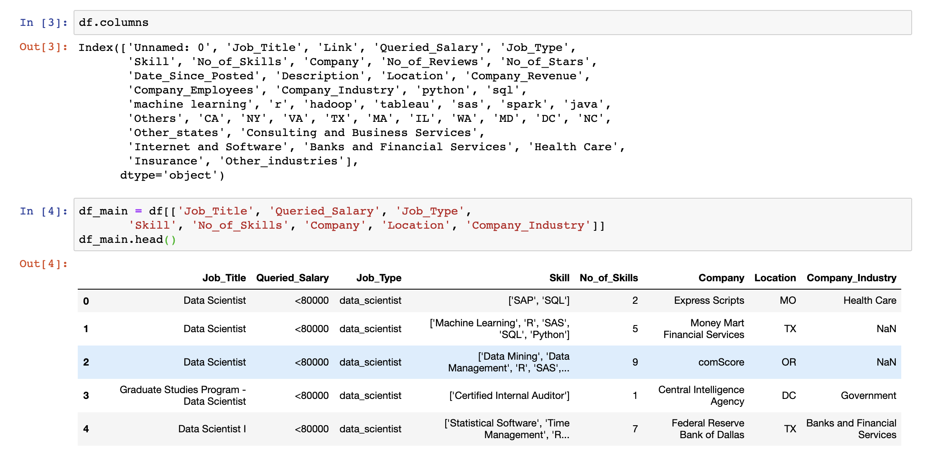
Flowchart
Process of data cleaning
Got it from Kaggle
It’s 9-months old
What does it look like? Columns etc?
Pre-cleaning

Slide 5
Shilpa – 2-3 slides here
What is the distribution of data jobs by state?

Slide 6
Han – 2-3 Slides
What is the distribution of skills?

Slide 7
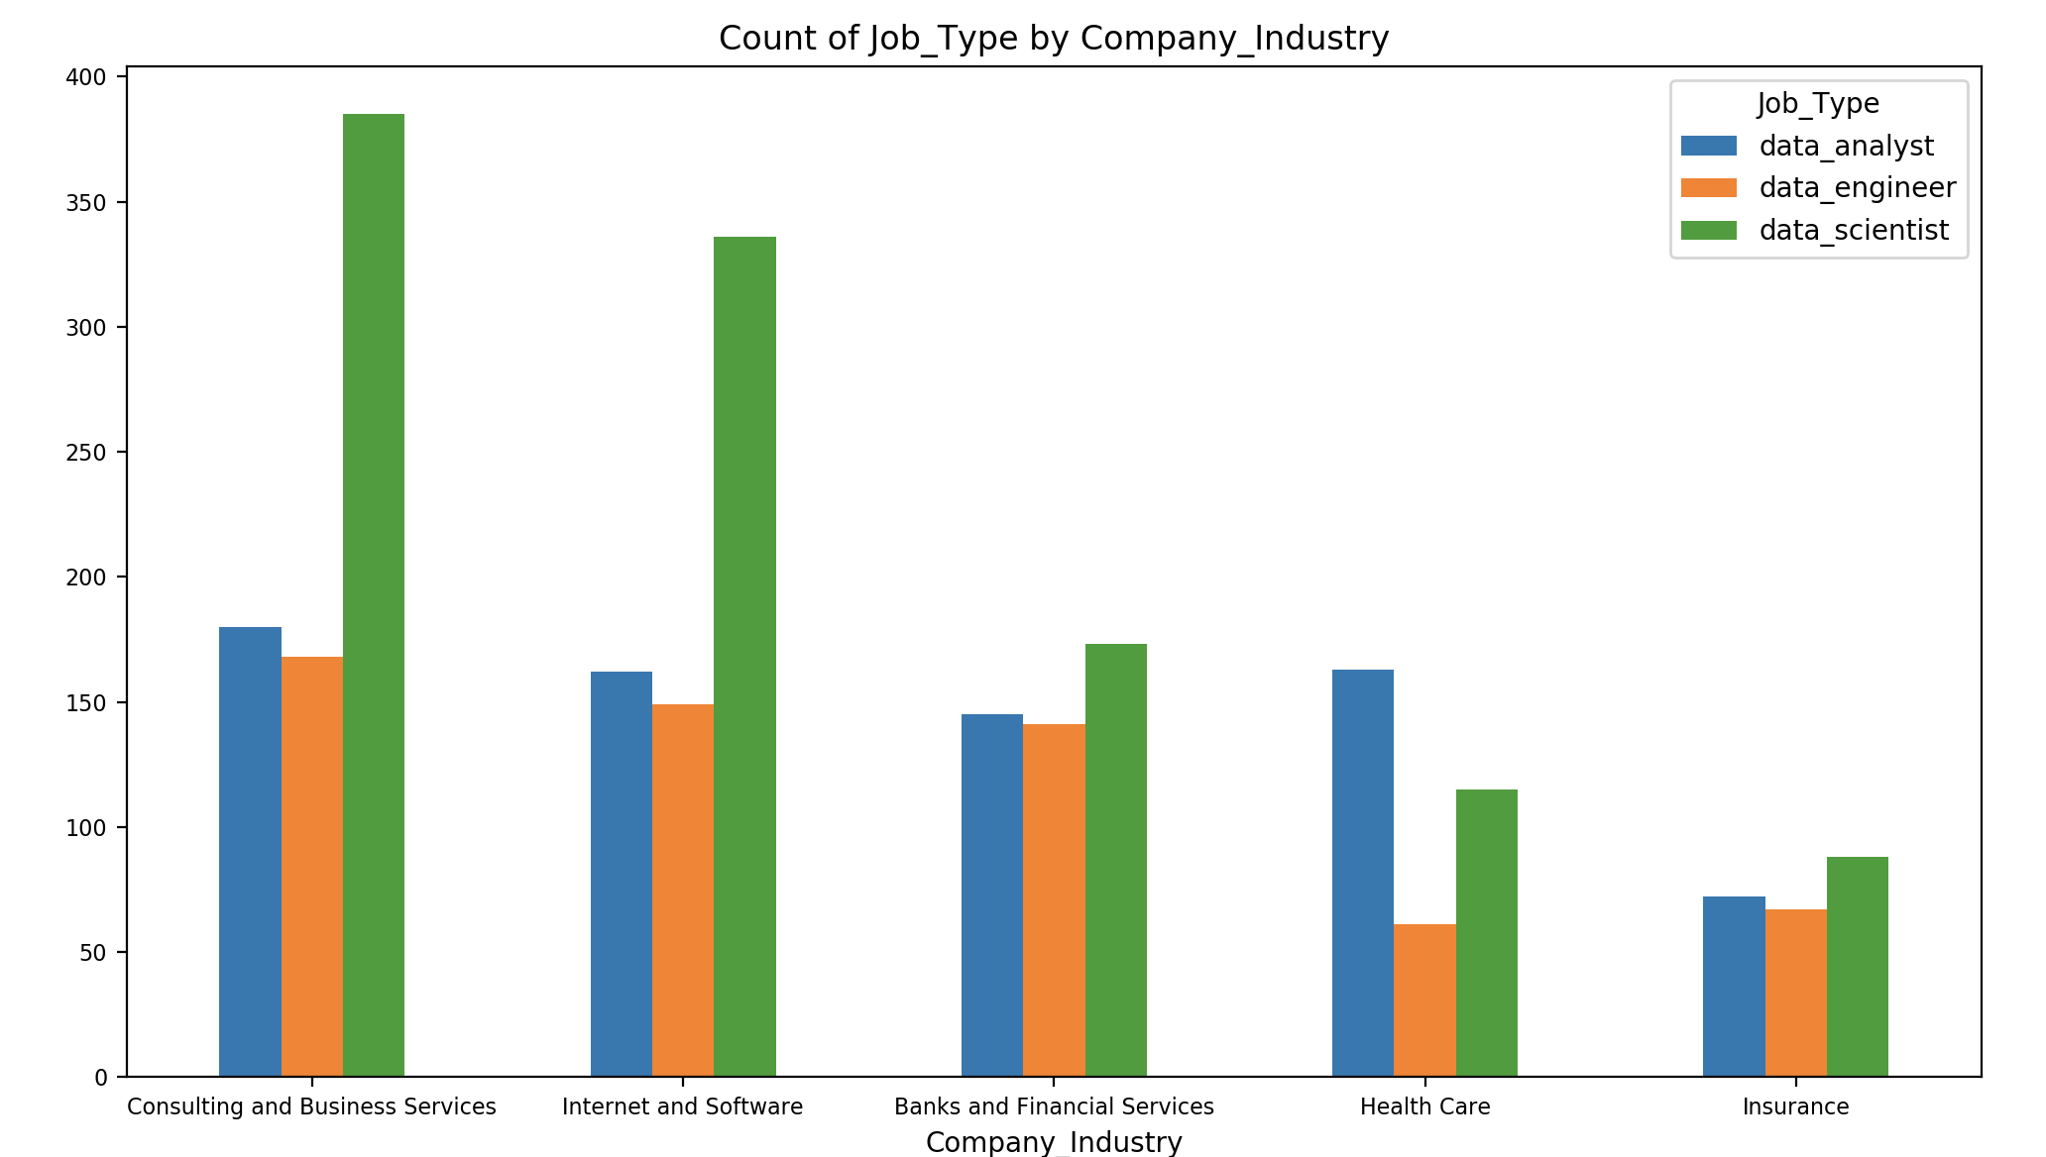
Jobs Counts in the top Industries
What is the distribution of “data jobs” in different industries?
Graph of total job counts in each industry

Slide 8
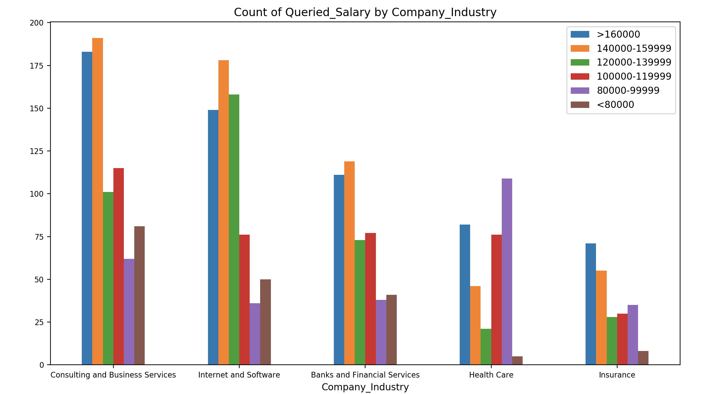
Salaries in the top Industries
What is the distribution of “data jobs” in different industries?
Graph of total job counts in each industry

Slide 9
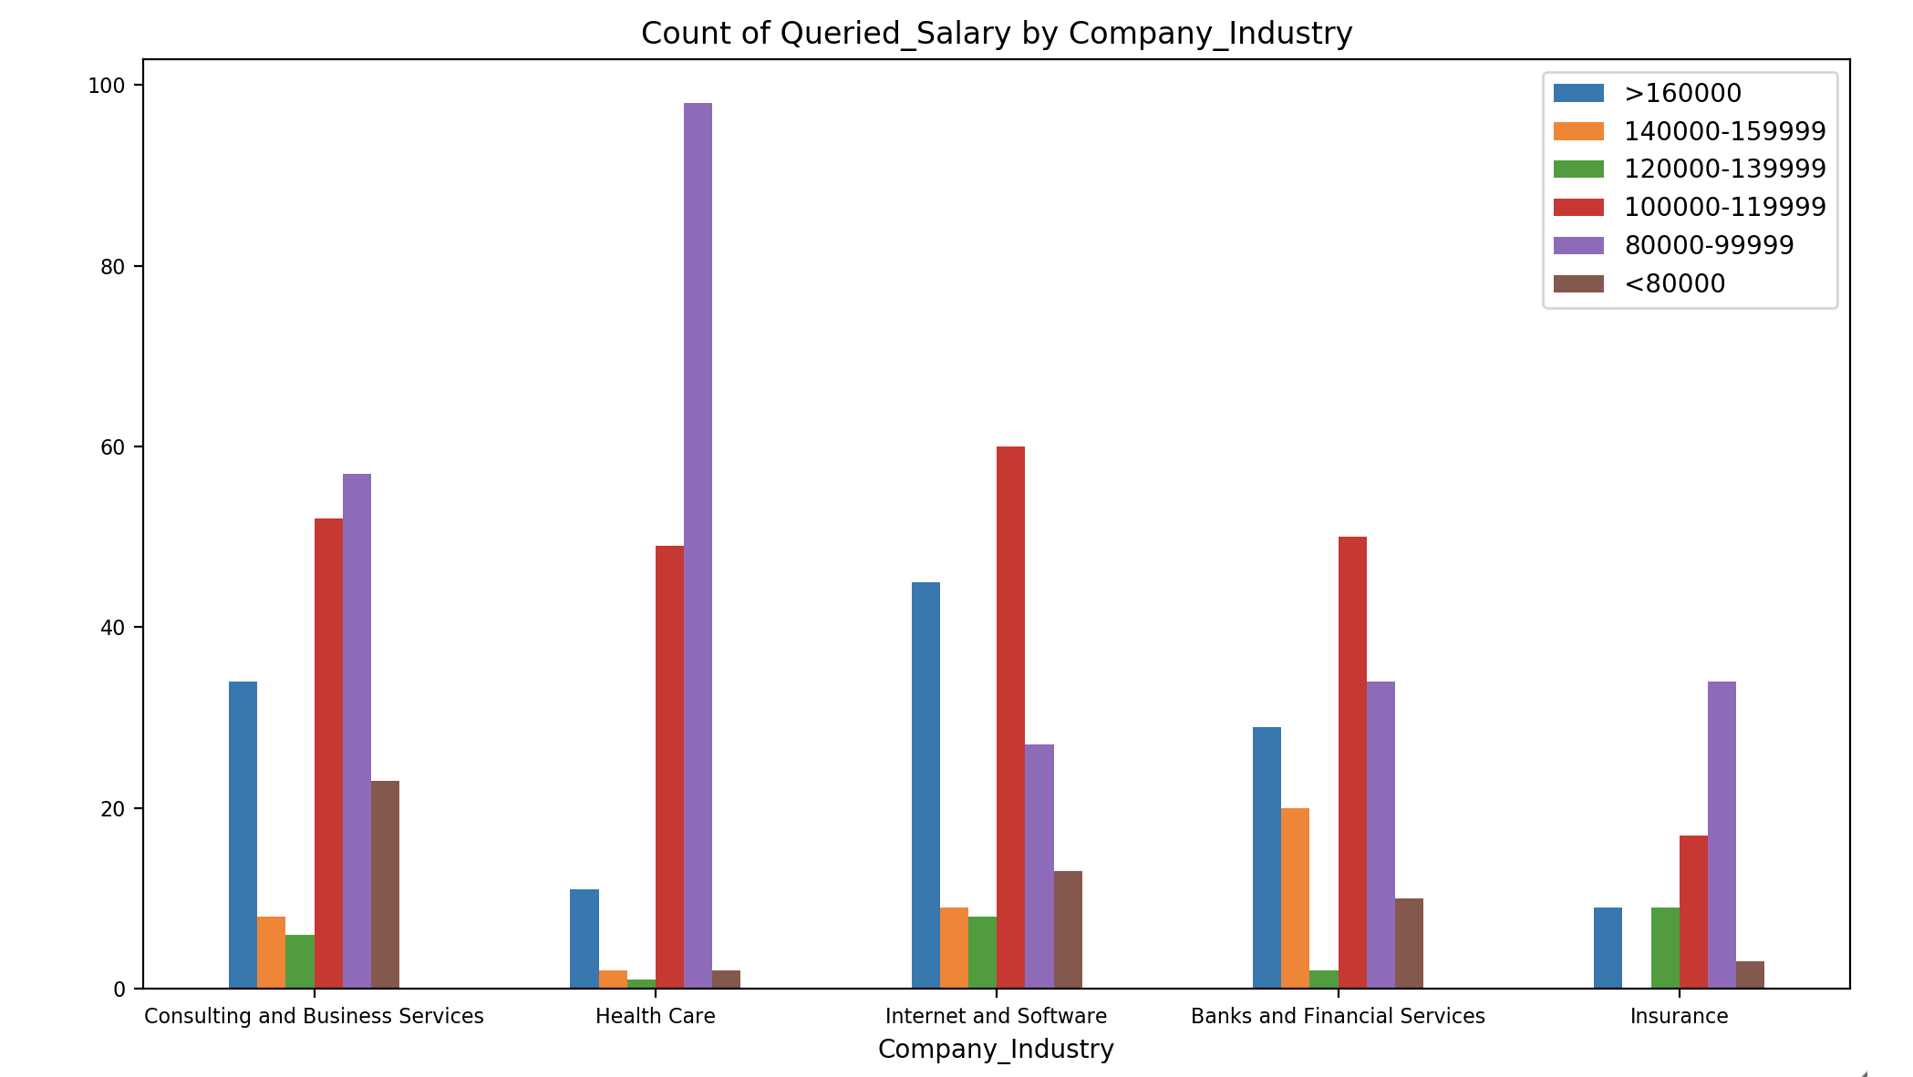
Data Analyst Salaries in the Top Industries
What is the distribution of “data jobs” in different industries?
Graph of total job counts in each industry

Slide 10
Major conclusions – we each reiterate from our slides
States
Skills
Industries

Slide 11
The End
Questions?

